Slide 1

TECHNICALLY full Employment
An Analysis of Glassdoor Reviews of Tech Companies with Low Employee Tenure

Slide 2

Tech Industry Overview
IT industry employed 3.9 million in 2014
Expected to grow 12 percent by 2024
Growth could be accelerated by COVID-19
One of the highest industry turnover rates: 13.2%

Slide 3

Why does turnover matter?
Potential for high replacement cost
Turnover = separations during the period / avg number of employees

Slide 4

2019 ADP State of the Workforce Report
Tech Industry Statistics:
5.6 years = average tenure
Workers with <4 years tenure are 2x more likely to turn over

Slide 5
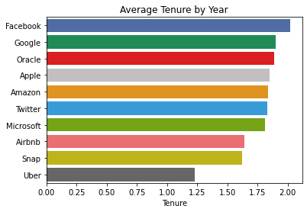
2017 BI: Tech Giants Ranked by Tenure
Facebook: 2.02 years
Google: 1.90 years
Oracle: 1.89 years
Apple: 1.85 years
Amazon: 1.84 years
Twitter: 1.83 years
Microsoft: 1.81 years
Airbnb: 1.64 years
Snap Inc.: 1.62 years
Uber: 1.23 years

Slide 6
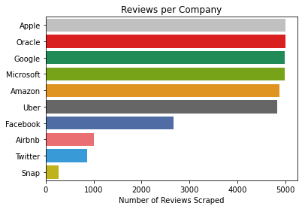
Method: Scraping Glassdoor Reviews
Scraped roughly 30,000 company reviews from Glassdoor.com using selenium
Limited to 5000 most recent English reviews (if available)
Focused on ratings, both categorical and numeric
NLP on review content is a source for future research

Slide 7

Six Variables Considered
Overall Rating – score out of 5
Work/Life Balance Rating – x/5
Career Opportunity Rating – x/5
Outlook – positive, neutral, negative
Recommended – y, n
Opinion of CEO – approves, disapproves, no opinion

Slide 8
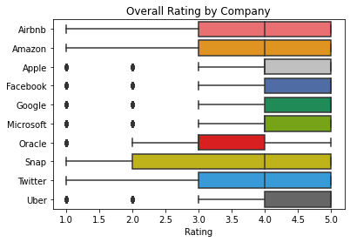
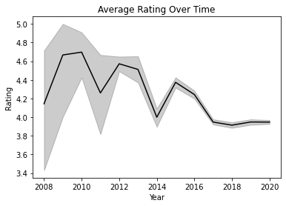
Overall Rating by Company

Slide 9
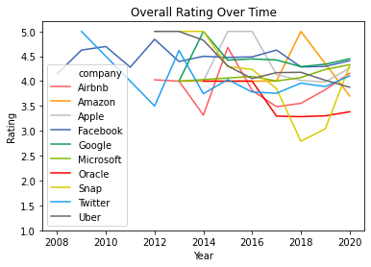
Overall Rating by Company

Slide 10
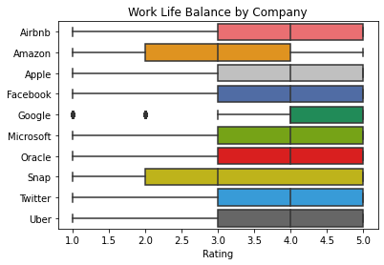
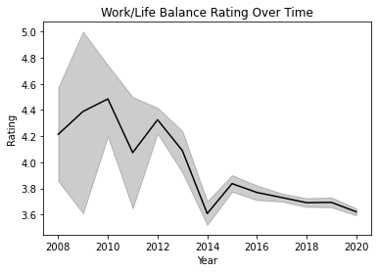
Work/Life Balance by Company

Slide 11
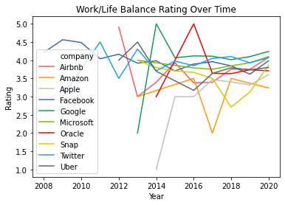
Work/Life Balance by Company

Slide 12
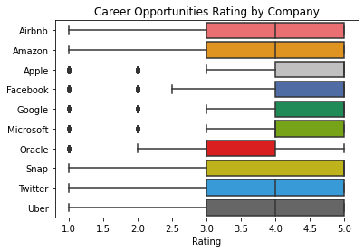
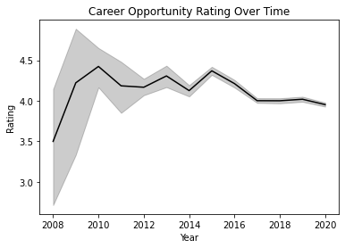
Career Opportunities by Company

Slide 13
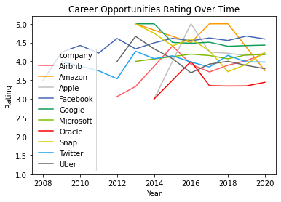
Career Opportunities by Company

Slide 14
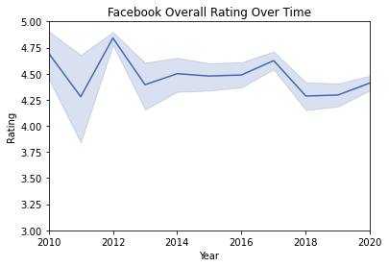
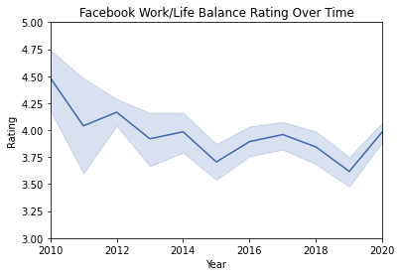
Ratings at Facebook

Slide 15
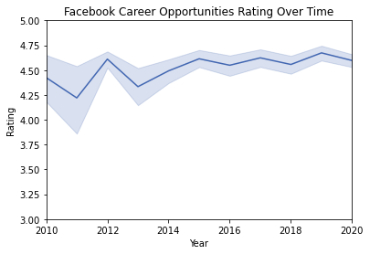
Ratings at Facebook

Slide 16
Ratings at Facebook

Slide 17
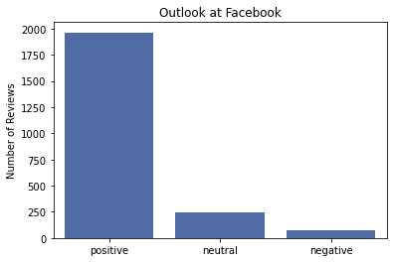
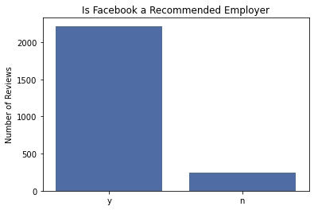
Soft Measurements at Facebook

Slide 18
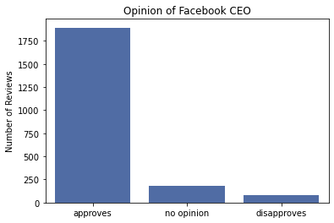
Soft Measurements at Facebook
Graphs and charts indicate a largely good opinion of Facebook’s trajectory
This contrasts significantly with public perception of Facebook, which is increasingly negative
Known for high employee benefits
Theory: a job at Facebook is a door- opener to a highly successful career in tech

Slide 19
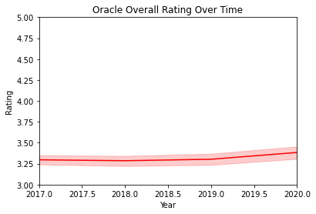
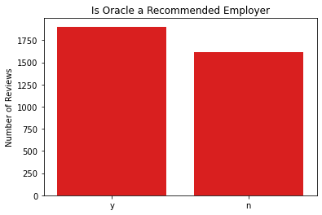
The Situation at Oracle

Slide 20
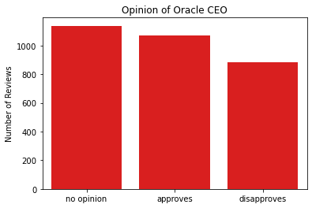
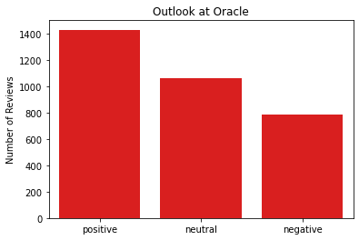
The Situation at Oracle

Slide 21
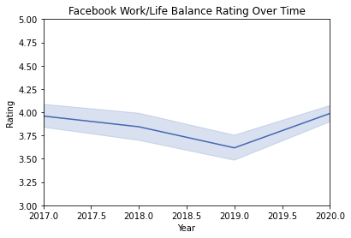
Facebook vs Oracle

Slide 22
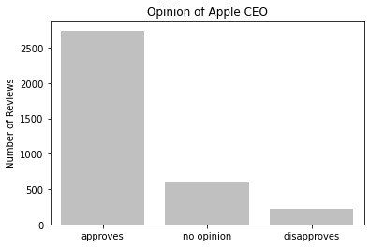
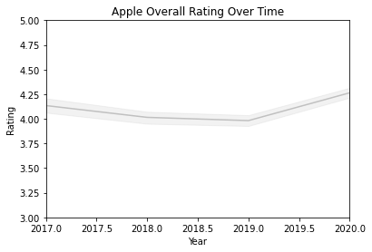
Apple’s Improved Measures

Slide 23
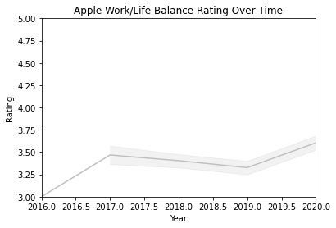
Apple’s Improved Measures
Emphasis on strong culture
Reinvestment in Employees
Building of their state of the art donut/spaceship headquarters
Providing a path to growth within the company
Improved retail retention rate from 61-89 percent over 5 years

Slide 24
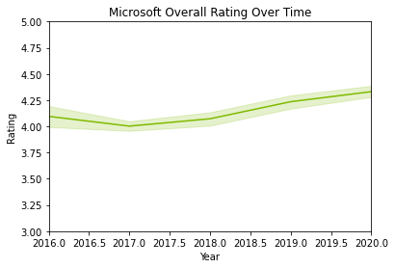
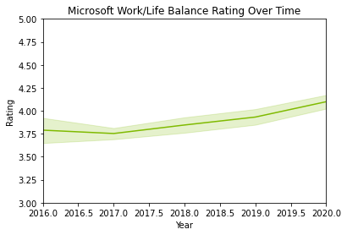
Microsoft’s Improved Measures

Slide 25
Inc.com Report on Microsoft’s Management
Reduce meeting size and frequency
Encourage blocked out time for concentrated work
Weekly check-in regarding time spent off hours sending emails

Slide 26

How can the paradigm be changed?
Increase employee benefits!
Facebook is known for a high level of employee benefits
Provide a more inclusive environment for employees as Apple has done
Increase work/life balance as Microsoft has done

Slide 27

Opportunities for Further Research
Scrape all available data, not limited by number of reviews
Will increase picture of ratings over time
Perform NLP analysis on the content of each review
Consider COVID-19’s effects on work done off-hours

